Slide 1
K-Nearest Neighbour - classification algorithm
Jayaraj P B
1

Slide 2
Outline
Supervised Classifier
KNN - Overview
Working of KNN
Pros & Cons
Sample problem

Slide 3
Supervised Classifiers
Test instances with unknown categories
X1
X2
feature
values
X3
Y
…
Classifier
category
Xn
DB
collection of instances with known categories

Slide 4
K-Nearest Neighbour
The K-Nearest Neighbors (KNN) algorithm is a supervised machine learning method employed to tackle classification and regression problems.
Evelyn Fix and Joseph Hodges: They introduced the k-NN algorithm in their paper "Discriminatory Analysis, Nonparametric Discrimination: Consistency Properties" published in 1951.
Thomas Cover and Peter Hart: They popularized the k-NN algorithm and demonstrated its effectiveness in classification tasks in their seminal paper "Nearest Neighbor Pattern Classification" published in 1967.
K-NN algorithm stores all the available data and classifies a new data point based on the similarity.

Slide 5
It is widely disposable in real-life scenarios since it is non-parametric, meaning it does not make any underlying assumptions about the distribution of data
It is also called a lazy learner algorithm because it does not learn from the training set immediately instead it stores the dataset and at the time of classification, it performs an action on the dataset.
KNN algorithm at the training phase just stores the dataset and when it gets new data, then it classifies that data into a category that is much similar to the new data.

Slide 6
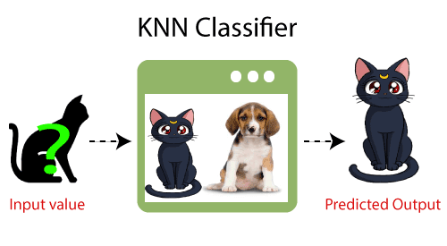
Example: Suppose, we have an image of a creature that looks similar to cat and dog, but we want to know either it is a cat or dog. So for this identification, we can use the KNN algorithm, as it works on a similarity measure. Our KNN model will find the similar features of the new data set to the cats and dogs images and based on the most similar features it will put it in either cat or dog category.

Slide 7
But there are two challenges:
1. What is the basis of this similarity or when can we say that two data elements are similar?
2. How many similar elements should be considered for deciding the class label of each test data element?

Slide 8
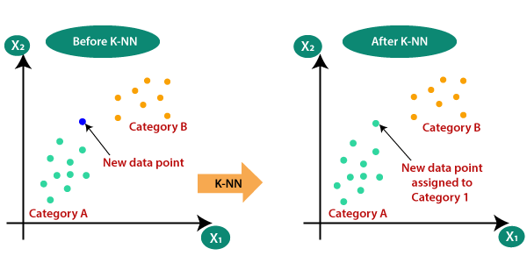
K-NN Algorithm
Suppose there are two categories, i.e., Category A and Category B, and we have a new data point x1, so this data point will lie in which of these categories

Slide 9
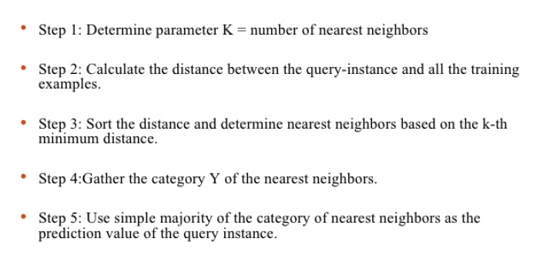
How K-NN Algorithm works

Slide 10
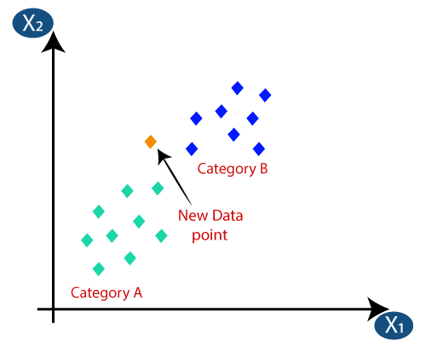
Suppose we have a new data point and we need to put it in the required category. Consider the below image:
Firstly, we will choose the number of neighbours, so we will choose the k=5.

Slide 11
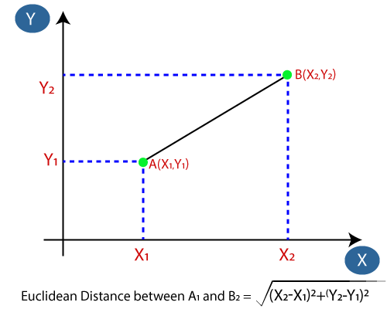
Next, we will calculate the Euclidean distance between the data points.
The Euclidean distance is the distance between two points, which we have already studied in geometry. It can be calculated as:

Slide 12
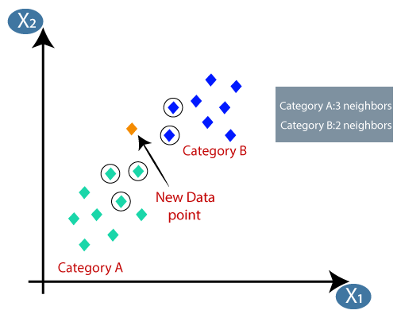
By calculating the Euclidean distance we will get the nearest neighbors, as three nearest neighbors in category A and two nearest neighbors in category B.
As we can see the 3 nearest neighbours are from category A, hence this new data point must belong to category A.

Slide 13
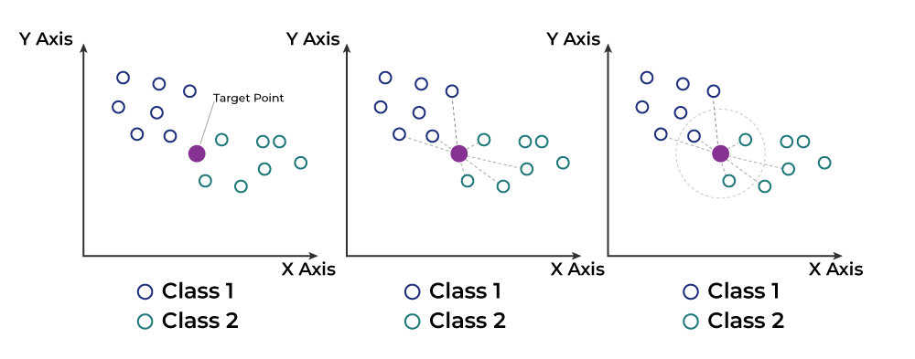
Working of KNN algorithm
Thе K-Nearest Neighbors (KNN) algorithm operates on the principle of similarity, where it predicts the label or value of a new data point by considering the labels or values of its K nearest neighbors in the training dataset.

Slide 14
In the regression problem, the class label is calculated by taking average of the target values of K nearest neighbors.
The calculated average value becomes the predicted output for the target data point.

Slide 15
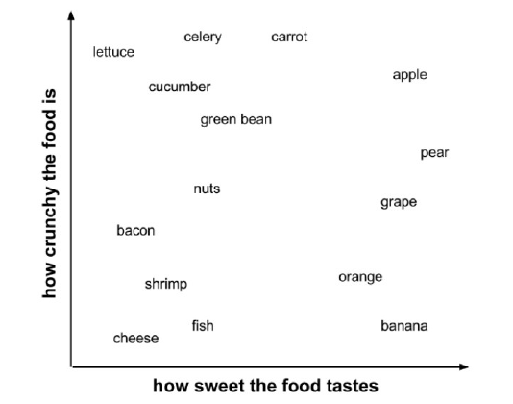
Example

Slide 16
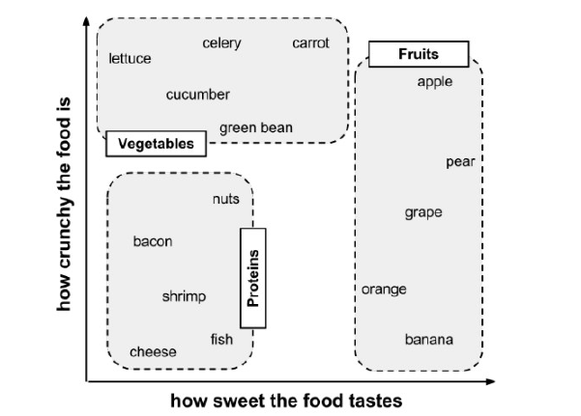

Slide 17
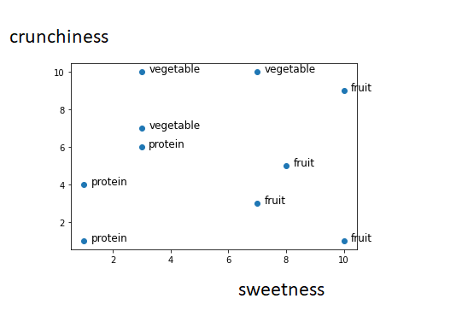
tomato (sweetness = 6, crunchiness = 4) ????

Slide 20
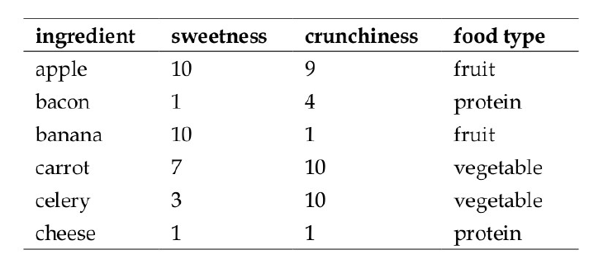

Slide 21
The distance formula involves comparing the values of each
feature.
To calculate the distance between the
tomato (sweetness = 6, crunchiness = 4), and the green bean
(sweetness = 3, crunchiness = 7), we can use the formula as follows:

Slide 22
tomato (sweetness = 6, crunchiness = 4) -> Fruit

Slide 23
Choosing appropriate k
In practice, choosing k depends on the difficulty of the concept to be learned and the number of records in the training data.
Typically, k is set somewhere between 3 and 10. One common practice is to set k equal to the square root of the number of training examples.
In the classifier, we might set k = 4, because there were 15 example ingredients in the training data and the square root of 15 is 3.87.

Slide 24
Values of K
But it is often a tricky decision to decide the value of k. The reasons are as follows:
If the value of k is very large (in the extreme case equal to the total number of records in the training data), the class label of the majority class of the training data set will be assigned to the test data regardless of the class labels of the neighbours nearest to the test data.
If the value of k is very small (in the extreme case equal to 1), the class value of a noisy data or outlier in the training data set which is the nearest neighbour to the test data will be assigned to the test data.

Slide 25
Value of K
Few strategies, highlighted below, are adopted by machine learning practitioners to arrive at a value for k.
One common practice is to set k equal to the square root of the number of training records.
An alternative approach is to test several k values on a variety of test data sets and choose the one that delivers the best performance.
Another interesting approach is to choose a larger value of k, but apply a weighted voting process in which the vote of close neighbours is considered more influential than the vote of distant neighbours.

Slide 26
Choosing appropriate k
Deciding how many neighbors to use for KNN determines how well the mode will generalize to future data.
The balance between overfitting and underfitting the training data is a problem known as the bias-variance tradeoff.
Choosing a large k reduces the impact or variance caused by noisy data, but can bias the learner such that it runs the risk of ignoring small, but important patterns.

Slide 27
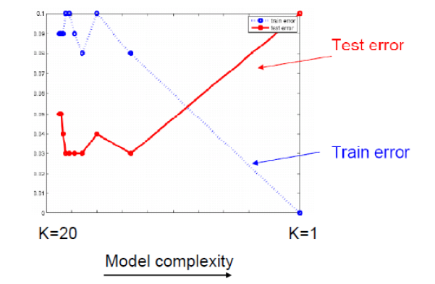

Slide 28
Distance Metrics Used in KNN Algorithm
As we know that the KNN algorithm helps us identify the nearest points or the groups for a query point.
But to determine the closest groups or the nearest points for a query point we need some metric.
For this purpose, we use below distance metrics:
Euclidean distance
Manhattan distance
Minkowski distance

Slide 29
Euclidean distance
This is nothing but the cartesian distance between the two points which are in the plane/hyperplane.
Euclidean distance can also be visualized as the length of the straight line that joins the two points which are into consideration.
This metric helps us calculate the net displacement done between the two states of an object.

Slide 30
Manhattan distance
Manhattan Distance metric is generally used when we are interested in the total distance traveled by the object instead of the displacement.
This metric is calculated by summing the absolute difference between the coordinates of the points in n-dimensions.

Slide 32
Manhattan Distance
Euclidean Distance

Slide 33
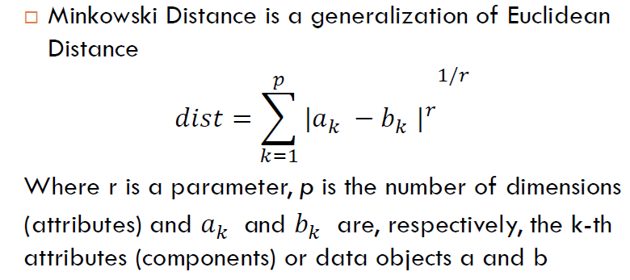
Minkowski distance

Slide 34
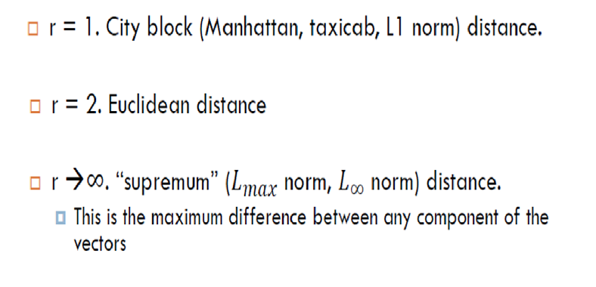
Minkowski distance

Slide 35
Hamming distance
There are other distance metrics as well like Hamming Distance which come in handy while dealing with problems that require overlapping comparisons between two vectors whose contents can be Boolean as well as string values.
The Hamming distance between two strings or vectors of equal length is the number of positions at which the corresponding symbols are different.
In other words, it measures the minimum number of substitutions required to change one vector into the other, or equivalently, the minimum number of errors that could have transformed one vector into the other.

Slide 36
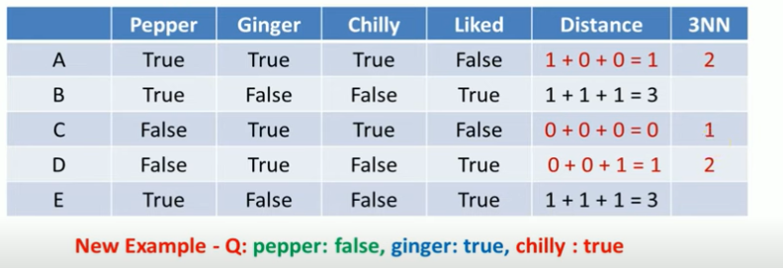
Hamming Distance

Slide 37
Other distance measures
City-block distance (Manhattan dist)
Add absolute value of differences
Cosine similarity
Measure angle formed by the two samples (with the origin)
Jaccard distance
Determine percentage of exact matches between the samples (not including unavailable data)

Slide 38
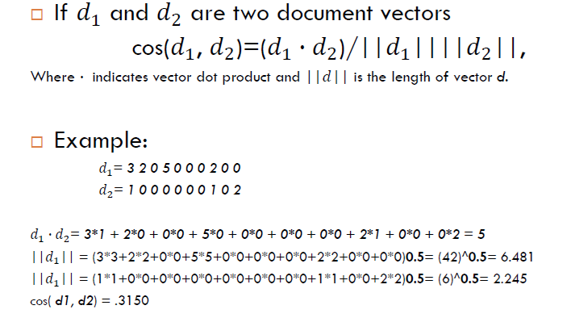
Cosine Similarity

Slide 39
Advantages of the KNN Algorithm
Easy to implement as the complexity of the algorithm is not that high.
Adapts Easily – As per the working of the KNN algorithm it stores all the data in memory storage and hence whenever a new example or data point is added then the algorithm adjusts itself as per that new example and has its contribution to the future predictions as well.
Very fast or almost no time required for the training phase
Few Hyperparameters – The only parameters which are required in the training of a KNN algorithm are the value of k and the choice of the distance metric which we would like to choose from our evaluation metric.

Slide 40
Disadvantages of the KNN Algorithm
Does not scale – As we have heard about this that the KNN algorithm is also considered a Lazy Algorithm.
The main significance of this term is that this takes lots of computing power as well as data storage. This makes this algorithm both time-consuming and resource exhausting.
Curse of Dimensionality – There is a term known as the peaking phenomenon according to this the KNN algorithm is affected by the curse of dimensionality which implies the algorithm faces a hard time classifying the data points properly when the dimensionality is too high.
Prone to Overfitting – As the algorithm is affected due to the curse of dimensionality it is prone to the problem of overfitting as well.
Hence generally feature selection as well as dimensionality reduction techniques are applied to deal with this problem.

Slide 41
Weakness
Does not learn anything in the real sense. Classification is done completely on the basis of the training data. So, it has a heavy reliance on the training data. If the training data does not represent the problem domain comprehensively, the algorithm fails to make an effective classification.
Because there is no model trained in real sense and the classification is done completely on the basis of the training data, the classification process is very slow.
Also, a large amount of computational space is required to load the training data for classification.

Slide 42
k-NN Time Complexity
Suppose there are m instances and n features in the dataset
Nearest neighbor algorithm requires computing m distances
Each distance computation involves scanning through each feature value
Running time complexity is proportional to m X n

Slide 43
Applications
Real-world applications of k-NN classification:
Image recognition
Spam email detection
Medical diagnosis
Credit risk assessment
Recommender systems

Slide 44
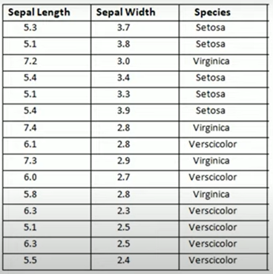
Problem
Solve the following question using KNN

Slide 45
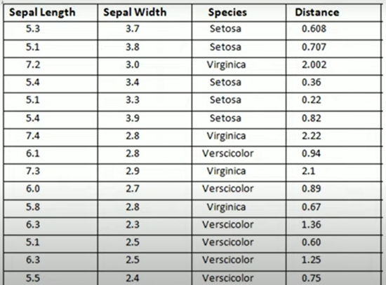

Slide 46
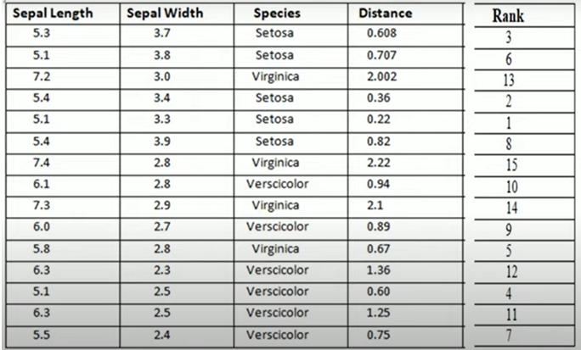
K=1, Setosa
K=2, Setosa……………K=5, Setosa

Slide 47
Problem for solving ?
|Feature1|Feature2|Feature3|ClassLabel|
|----------|---------|----------|------------|
| 5.1 | 3.5 | 1.4 | A |
| 4.9 | 3.0 | 1.4 | A |
| 7.0 | 3.2 | 4.7 | B |
| 6.4 | 3.2 | 4.5 | B |
| 6.3 | 3.3 | 6.0 | C |
| 5.8 | 2.7 | 5.1 | C |
| 5.7 | 2.8 | 5.1 | C |
| 6.7 | 3.1 | 4.7 | B |
| 5.6 | 2.8 | 4.9 | A |
| 5.4 | 3.4 | 1.5 | A |
| 6.9 | 3.1 | 5.4 | C |
| 6.7 | 3.0 | 5.2 | C |
| 6.0 | 2.9 | 4.5 | B |
| 6.3 | 2.3 | 4.4 | B |
| 6.4 | 3.1 | 5.5 | C |
| 5.5 | 3.0 | 4.0 | ??? |
-------------------------------------------
Given the dataset with three features (Feature1, Feature2, Feature3) and corresponding class labels (A, B, C), How can we use the K Nearest Neighbor algorithm to classify a new data point (shown in the last row) into one of the classes based on its similarity to the existing data points?

